Slide 1
CST-247 Milestone
Final Project Presentation with Shawn and Richard

Slide 2
Presentation Overview
Technical Design
UML
ERD
Functionality
Database and Models
Controllers and Services
Layout and Views
Challenges
Demo of Product

Slide 3
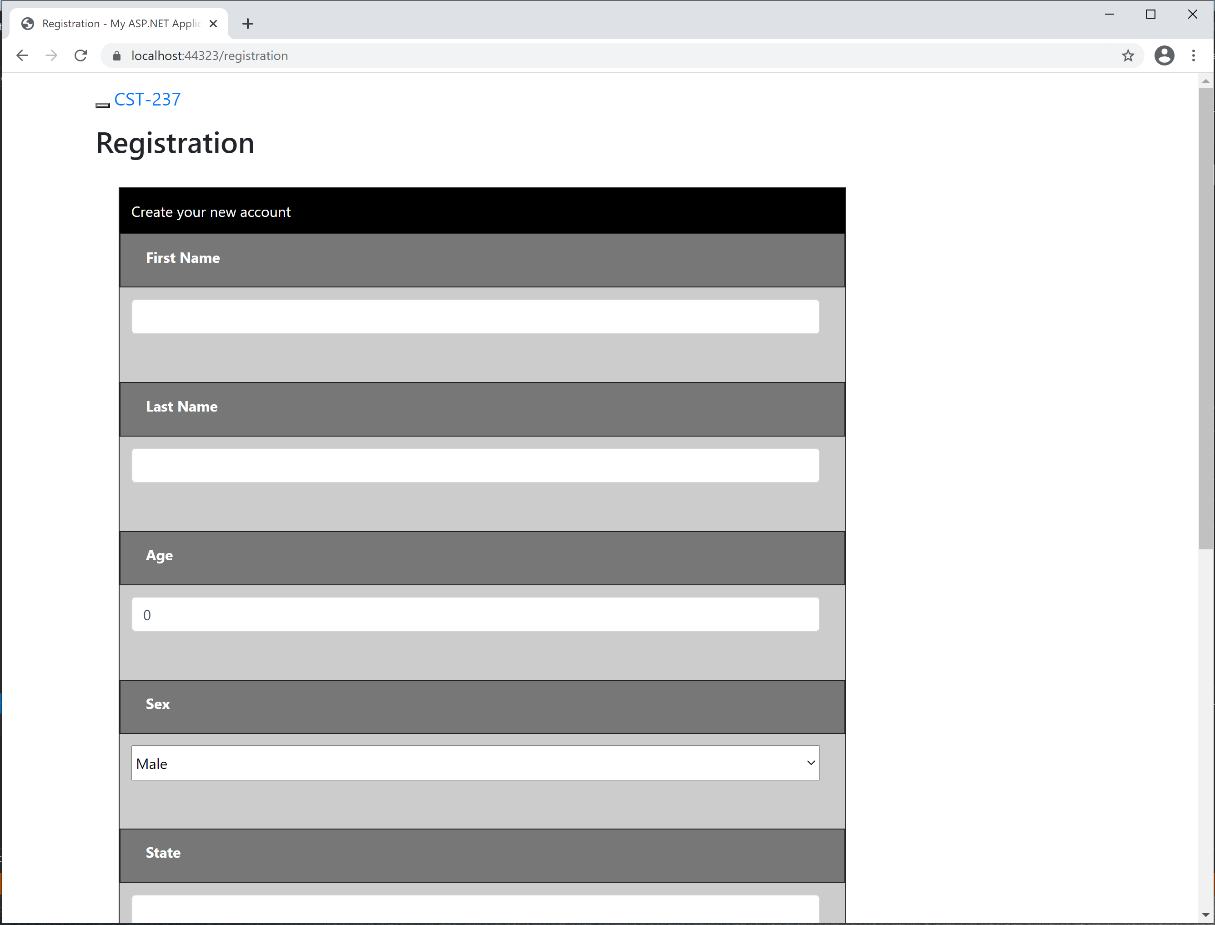
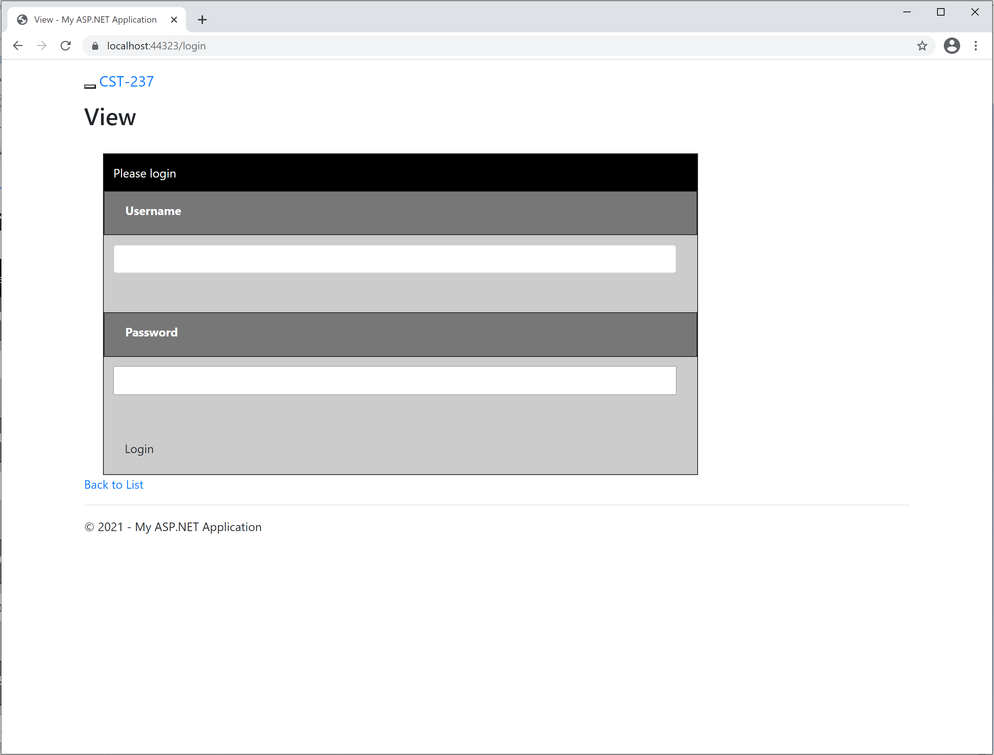
Progress of Application: milestone 2

Slide 4
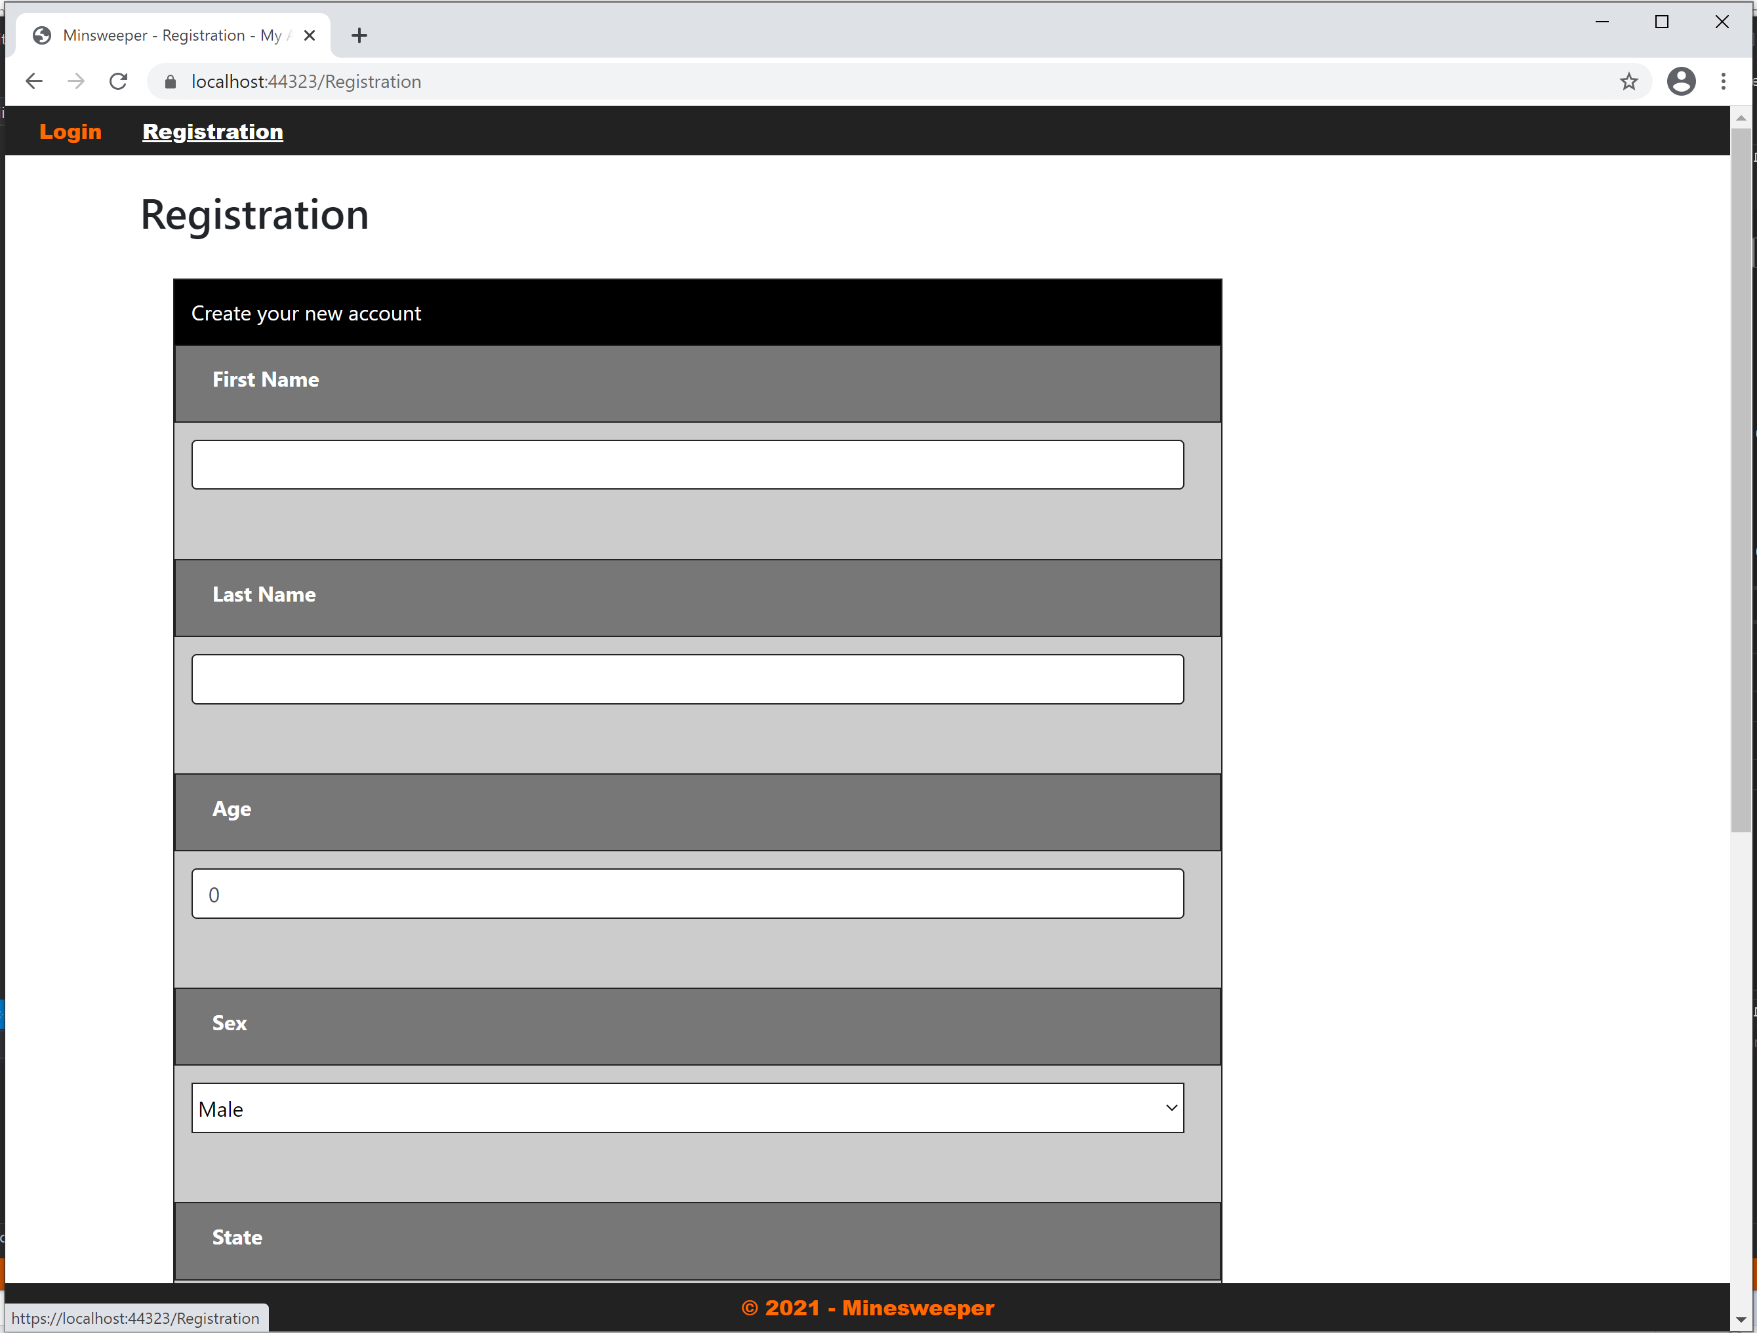
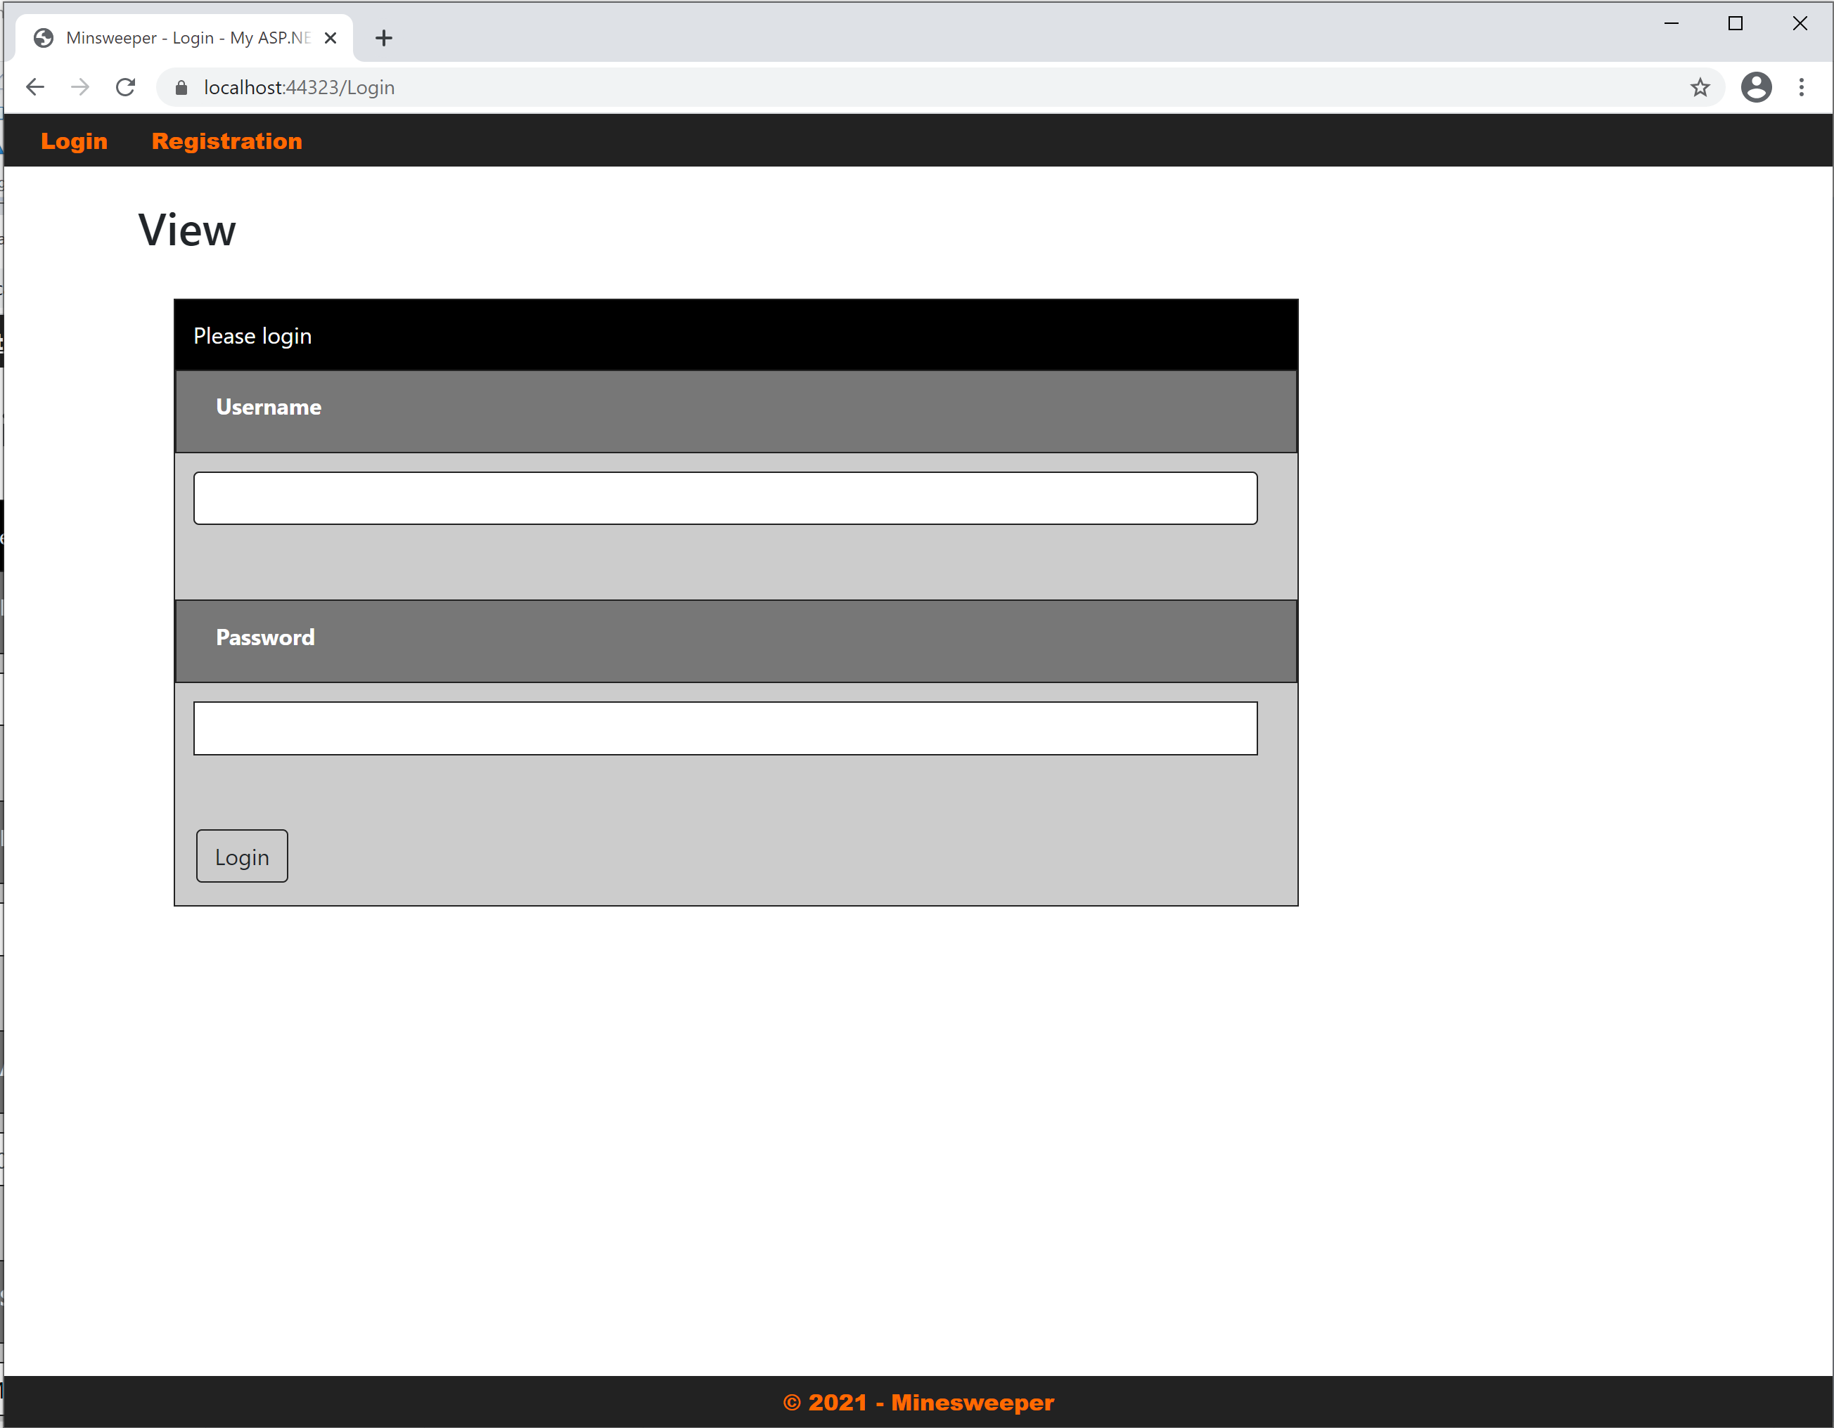
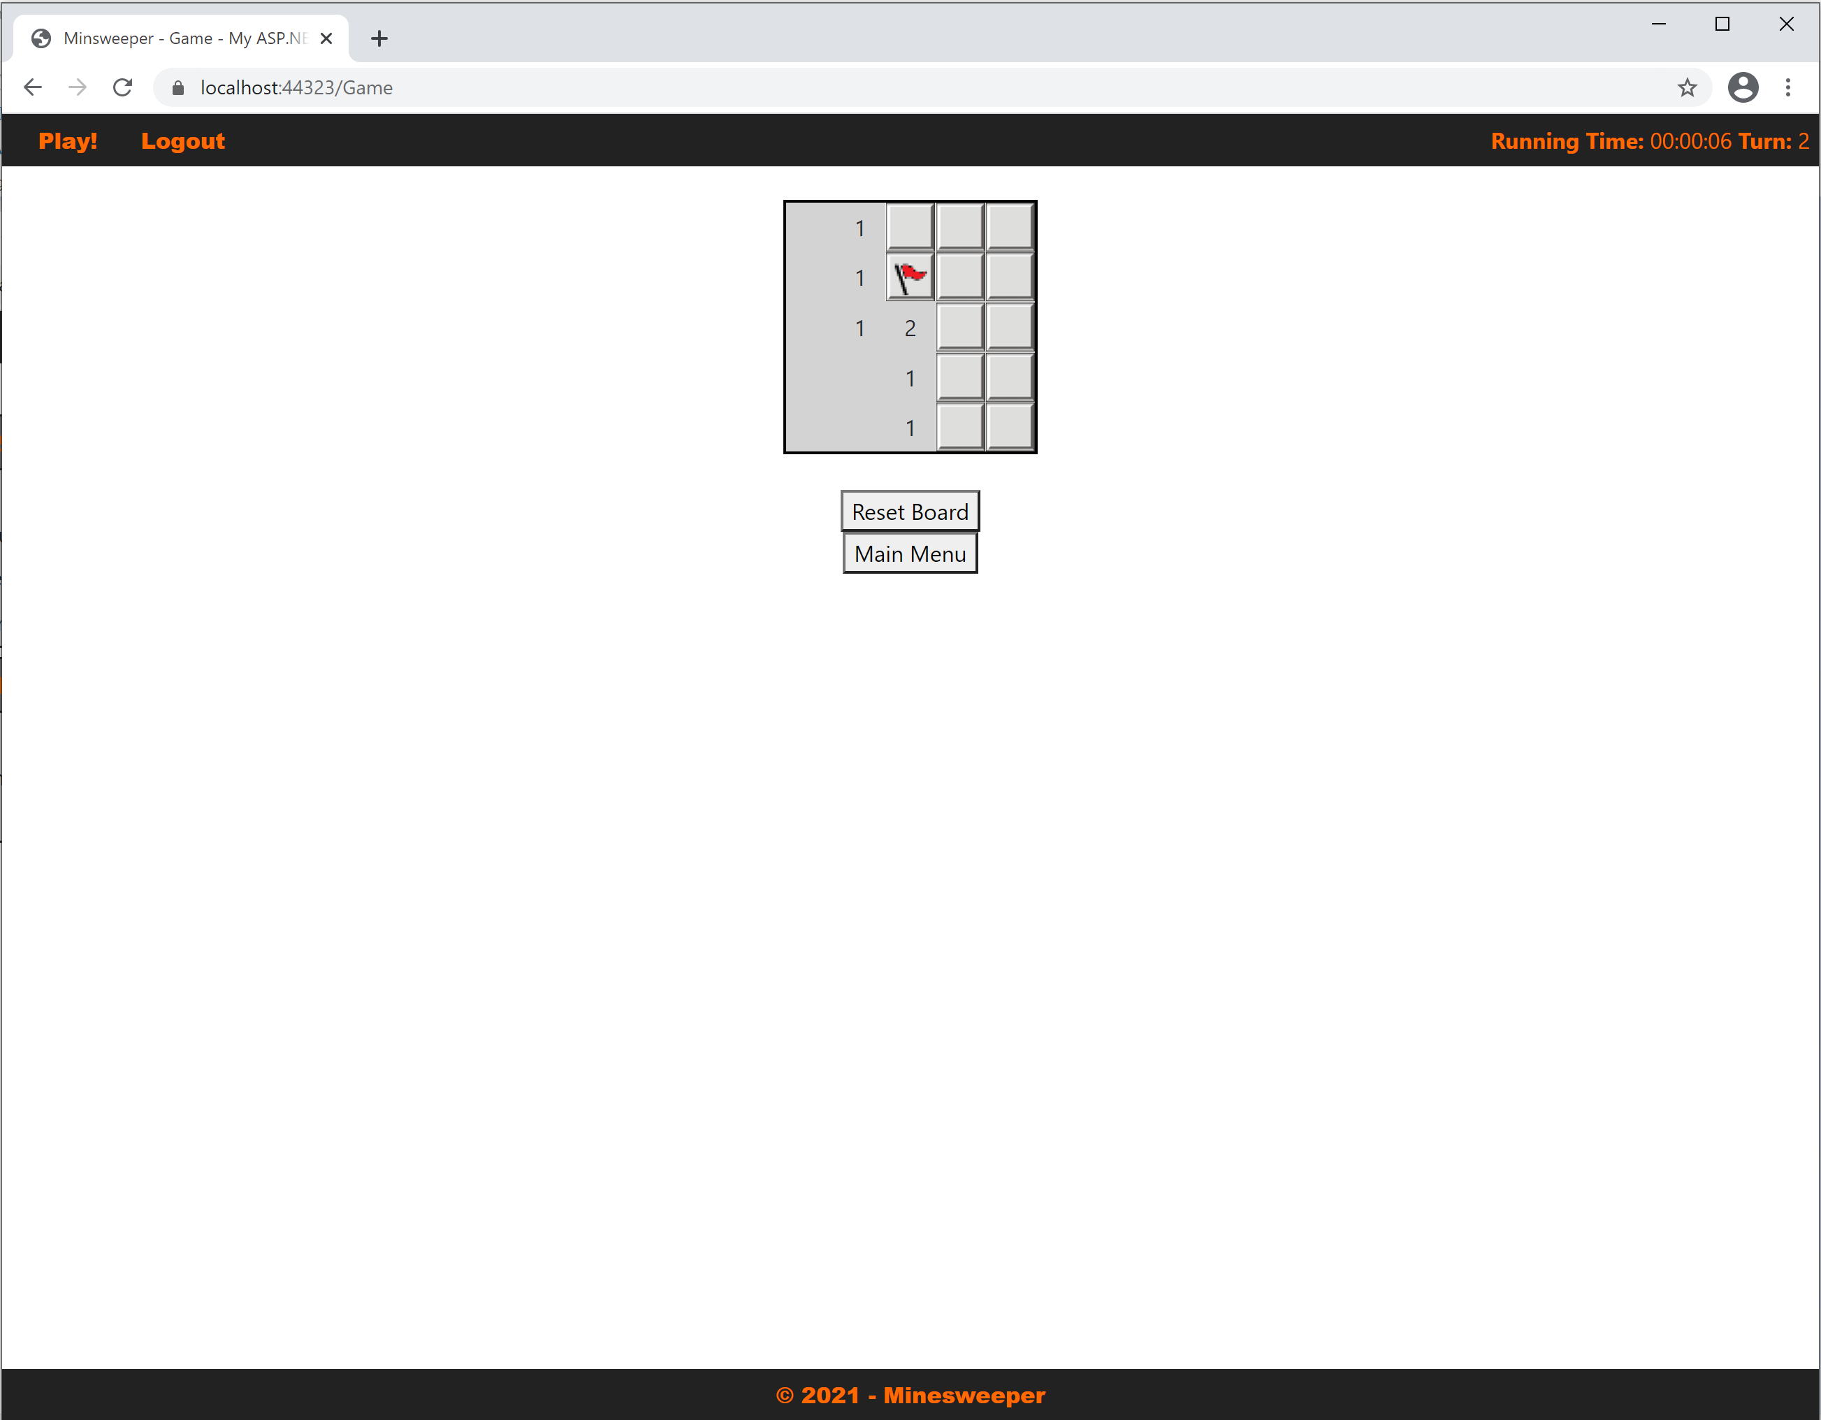
Progress of Application: milestone 4

Slide 5
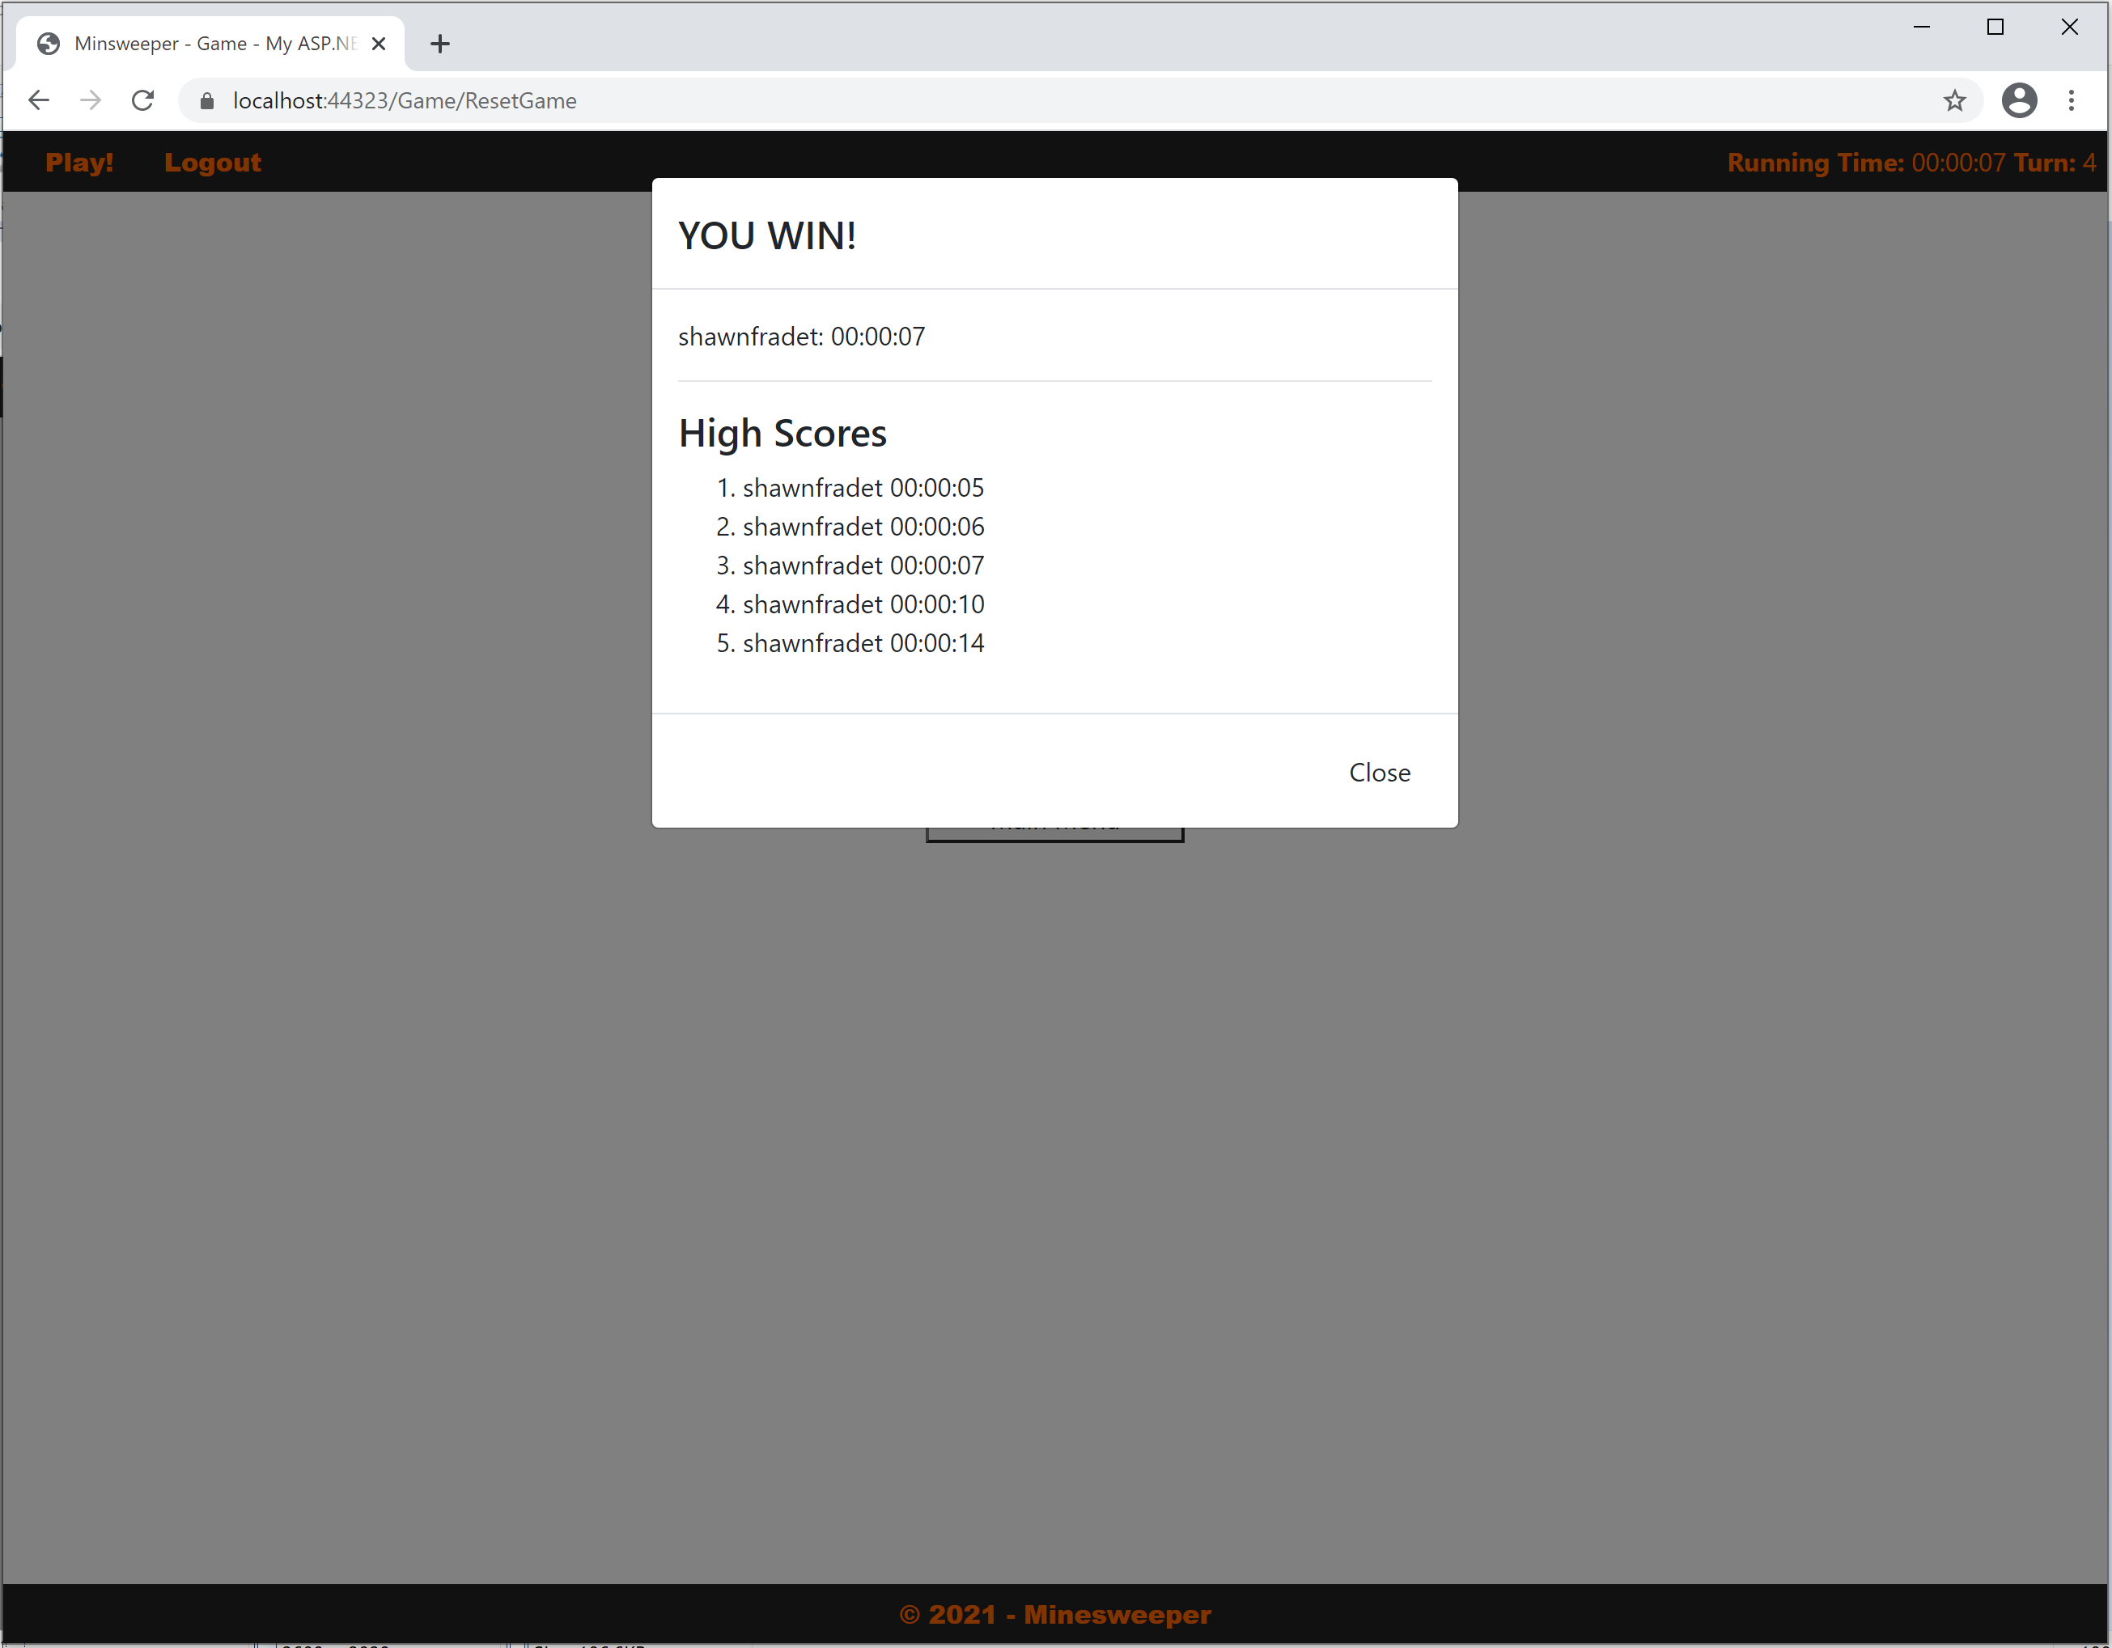
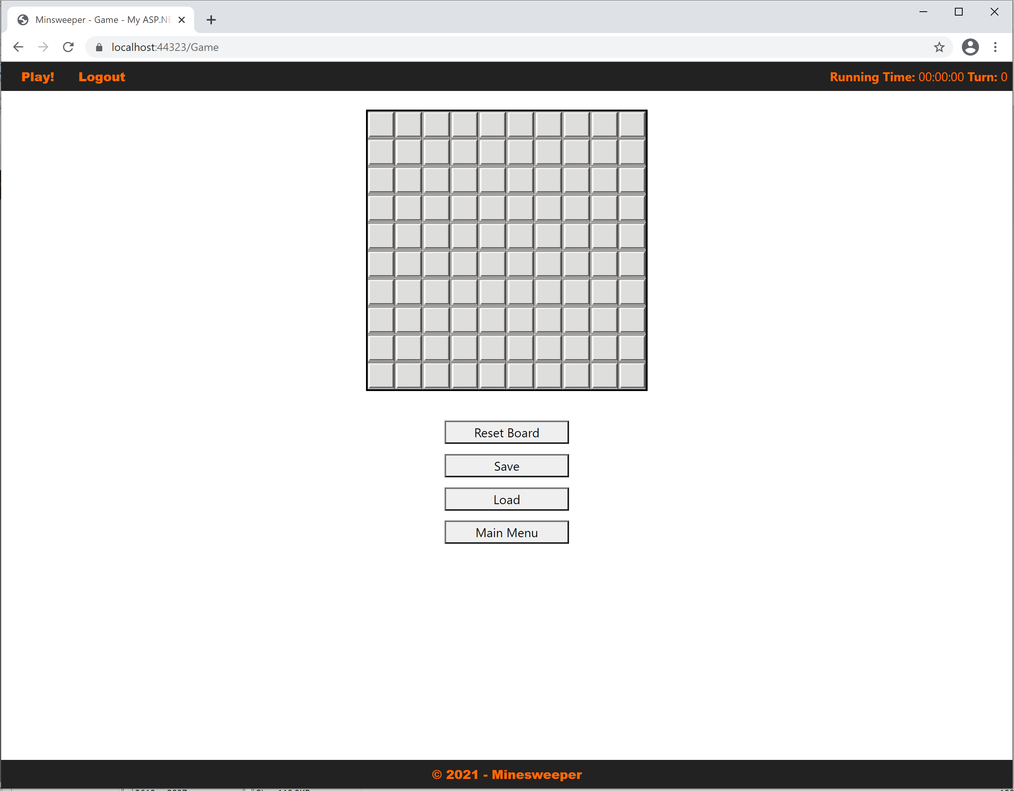
Progress of Application: milestone 5

Slide 6
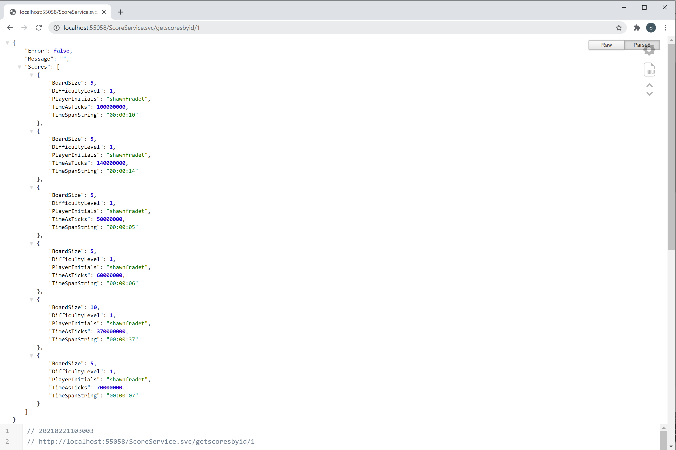
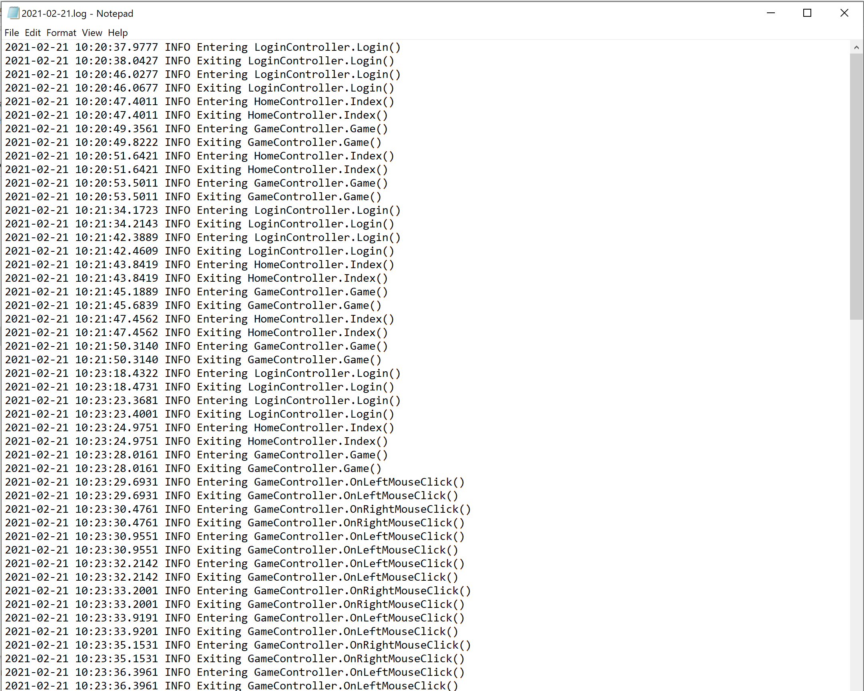
Progress of Application: milestone 5

Slide 7
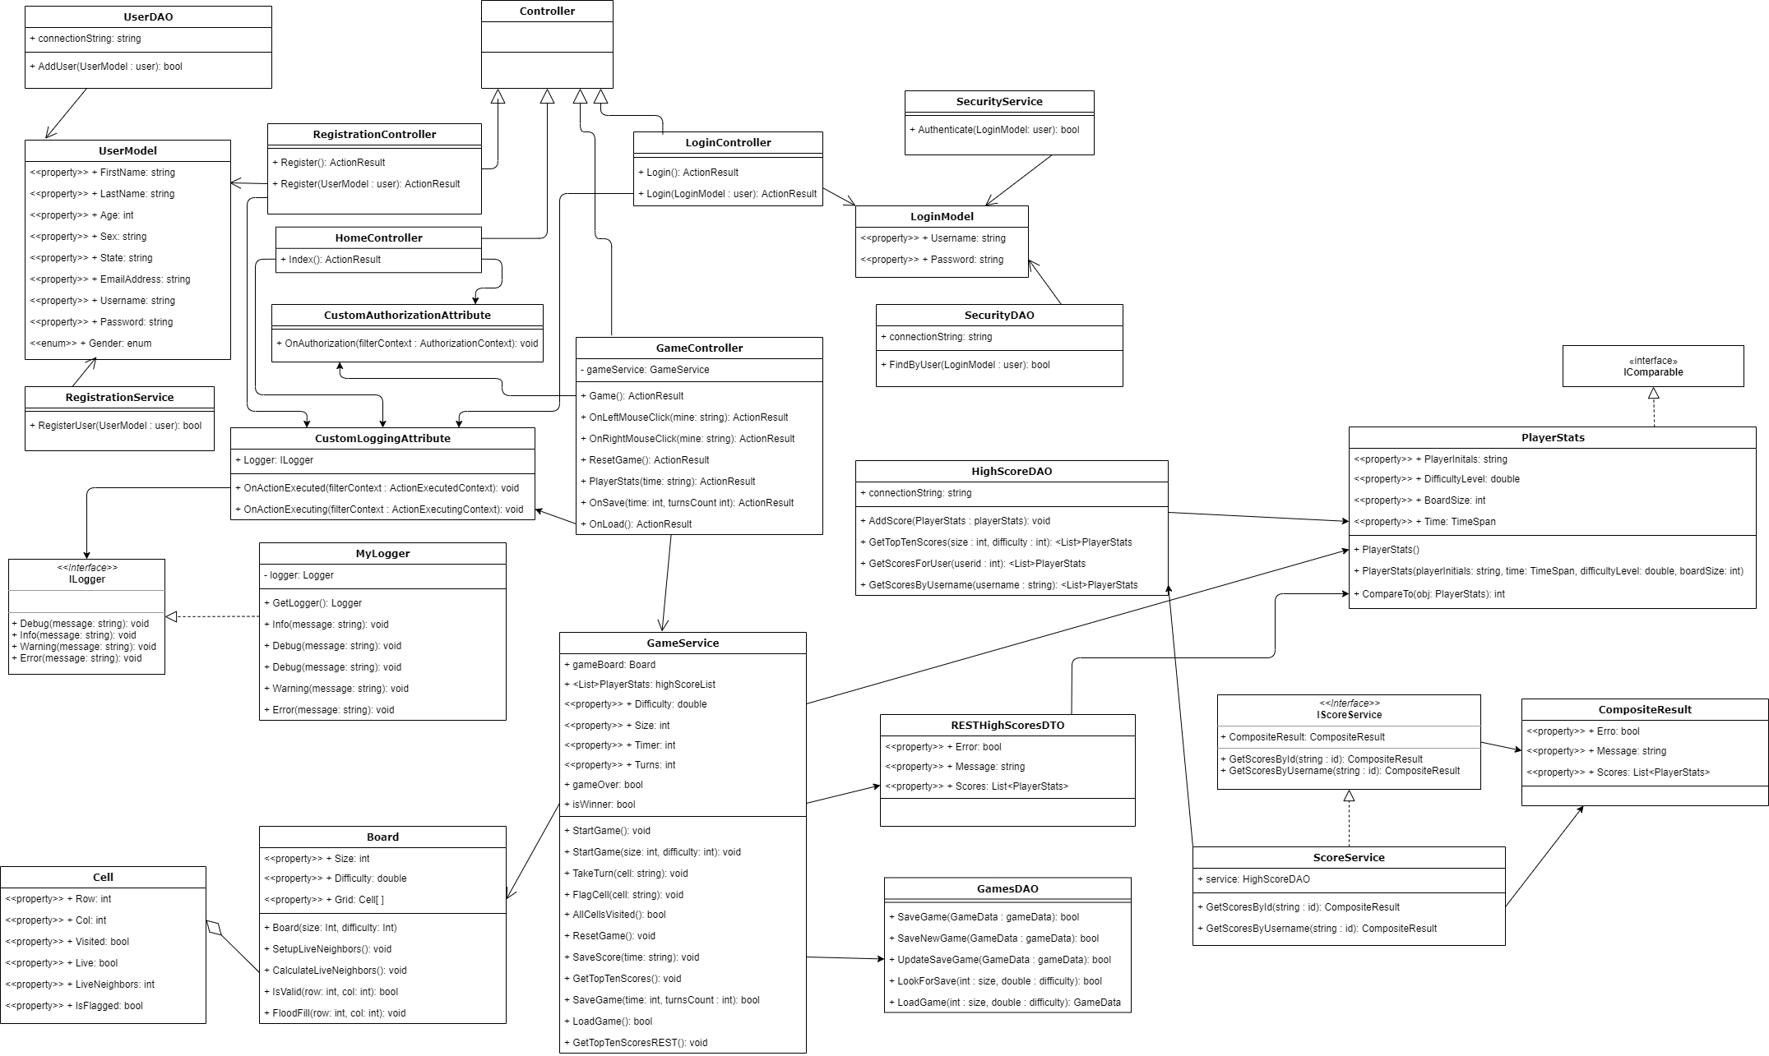
Technical Design: UML

Slide 8
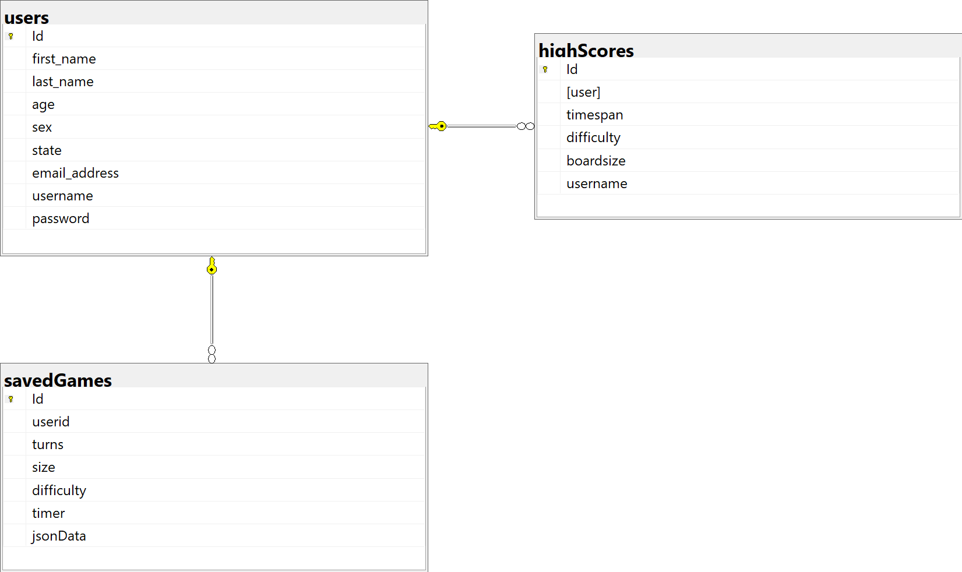
Technical Design: ERD

Slide 9

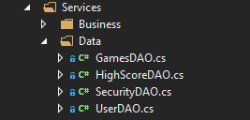

Functionality: Database and Models
DAO design
Connection string saved as constant, counts on local running service. Using windows authentication.
Models are Plain C# classes
Use annotations for data validation and REST API JSON returns

Slide 10
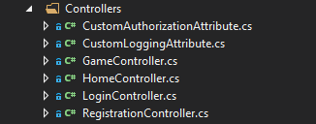
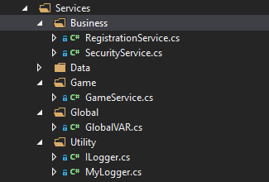
Functionality: Controllers and Services
Controllers receive request to an action which handles view selection and data validation.
Models have annotations which denote which fields must be filled out controller verifies there was not a failure in the given data in a POST.
Model is retrieved via Services and then passed to views
Services handle most of the business logic

Slide 11
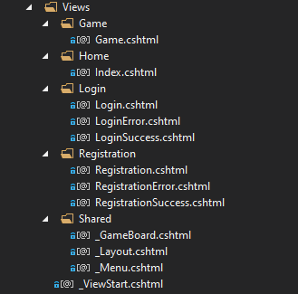
Functionality: Layout and Views
Uniform layout design handles the templating which is _Layout.cshtml
Breaks down into Header, body, footer
Subsequent views only render the body portion
The GameBoard view uses partial views for reactive loading of data needed, opposed to loading the full page.

Slide 12
Challenges
UI Styling could be improved to be more appealing
Initially we had issues where the game did not show the expected cells upon clicking a bomb.
Testing issues in browsers, no one used internet explorer
Had issues trying to secure the REST API using basic authentication
Spent 4 – 5 hours going through read me and how to’s to still not have functioning authentication.

Slide 13
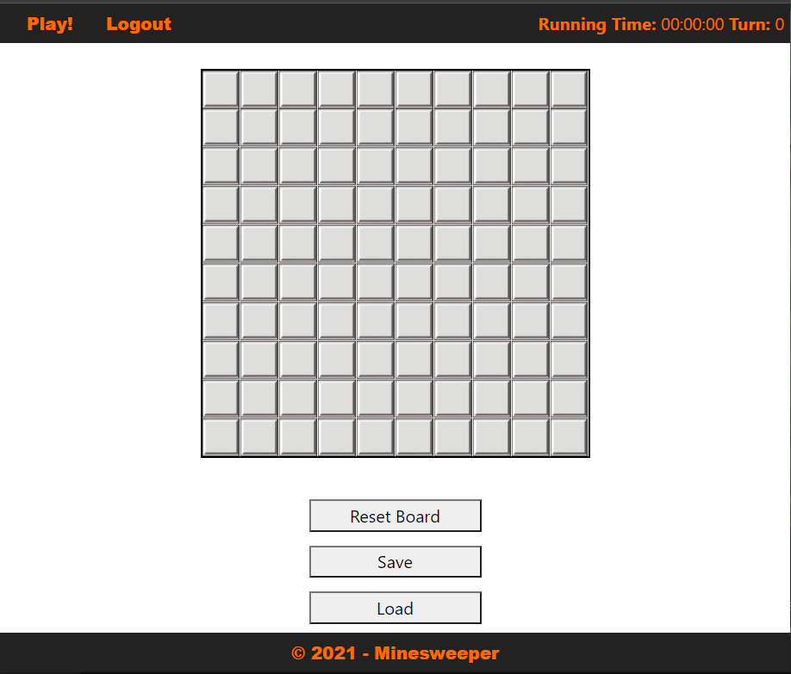
Demo of Product

